Slide 1


GUIDED BY
Mr. R. PREMKUMAR
PRESENTED BY
MOHANRAJ.S (927622BME054)
NATHISH.M (927622BME056)
DEPARTMENT OF MECHANICAL ENGINEERING
VACUUM ASSISTED MATERIAL FILLING MACHINE
MINOR PROJECT

Slide 2
Introduction
The Vacuum Assisted Material Filling Machine addresses the long-standing challenges associated with traditional filling methods, including material waste, contamination, and labor-intensive processes. By harnessing the power of vacuum technology, this machine ensures accurate and precise filling, while also reducing the risk of material spillage and contamination.

Slide 3
LIST OF COMPONENTS
1.vacuum cleaner
2.stainless steel
3.Rubber caster wheel
4.Sack bag
5.screw
6.cutting machine

Slide 4
COST ESTIMATION
S.NO COMPONENTS COSTS
1 vacuum cleaner 1399
2 stainless steels 300
3 Rubber caster wheel 100
4 Sack bag 50
5 screw 50
6 cutting machine 200
TOTAL 2099/-

Slide 5
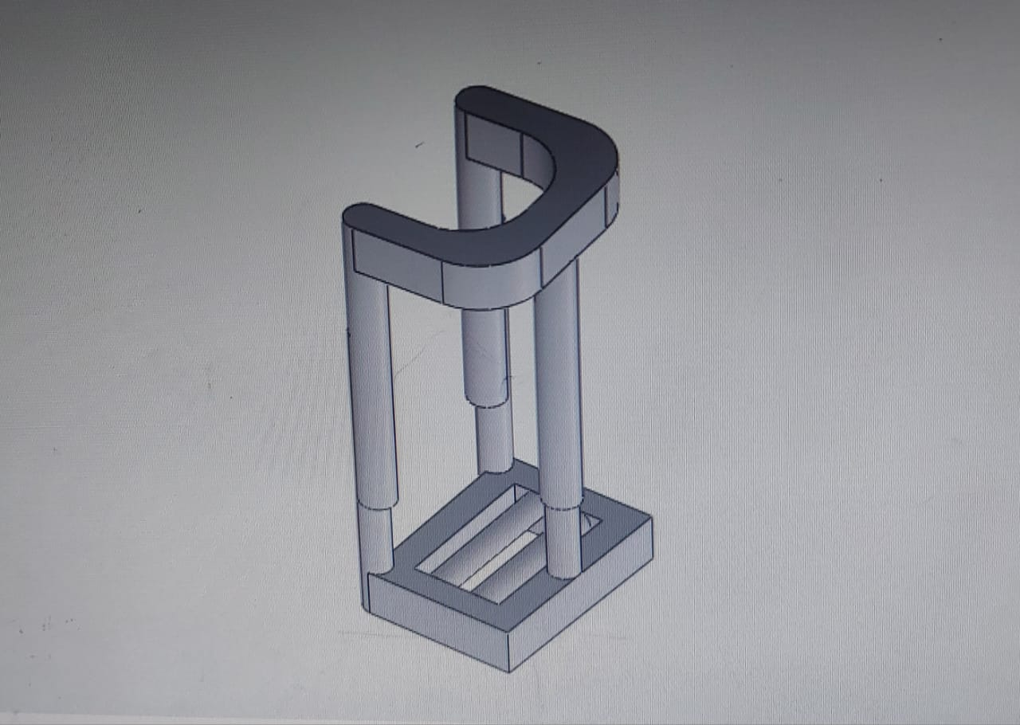
MODEL DIAGRAM

Slide 6
ADVANTAGE
Improved Filling Accuracy: Vacuum-assisted filling machines minimize human error, ensuring consistent and precise filling volumes.
Increased Efficiency: Automated filling processes reduce labor costs, increase productivity, and optimize production workflows.
Reduced Material Waste: Vacuum-assisted filling machines minimize material waste, reducing costs and environmental impact.
Enhanced Product Quality: Consistent filling volumes and material densities ensure uniform product quality, meeting stringent industry standards.

Slide 7
APPLICATION
It can fill the crops
It can fill the grains
It will be used for cleaning purpose in road side
It is used for agriculture purpose

Slide 8
Conclusion
The precision offered by this technology helps in reducing material waste, ensuring that the exact quantity is filled as required, thus optimizing the use of raw materials.
The closed-system design typically found in vacuum-assisted filling machines reduces the exposure of materials to the environment, enhancing safety and hygiene, especially important in sectors like food and pharmaceuticals.

Slide 9


